Slide 1
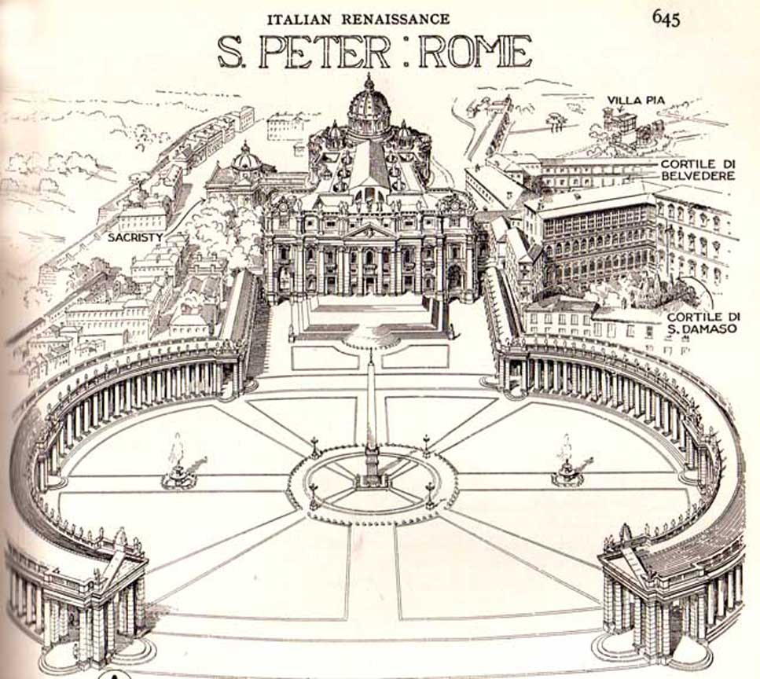

Catholic Ethics
Revd Dr Gareth Leyshon
2026 Conference
Gareth.Leyshon@
cardiffmenevia.org

Slide 2
Degrees of Practice
“I’m a Catholic” could mean:
  I was enrolled in the church as a baby
  I go to Church Christmas & Easter
  I live my life by the Church’s teachings
Notes:
Priest for 19 years. Tell the story about the parishioner who asked for a Thanksgiving for their grandchild – “it was the third cycle of IVF”

Slide 3
Catholic “Never Intents”
Never intend to destroy a human organism
Never create human life outside marital sex
Never impede the fertility of a natural act
A morality of principles
But for believers, also eternal consequences
Notes:
Our never-events are based on the idea that certain acts and certain intentions are ALWAYS WRONG – a deontological morality (but from the perspective of afterlife and judgment, doing duty has the best consequences)

Slide 4
Double Effect
Sedatives can shorten life of terminal patients
  Dose calculated for relief, shortens life, OK
  Dose calculated to hasten death, NOT OK
Hormone therapy reduces fertility
  Motive: control endometriosis, OK
  Motive: prevent dangerous pregnancy, NOT OK
Notes:
Our never-events are based on the idea that certain acts and certain intentions are ALWAYS WRONG – a deontological morality (but from the perspective of afterlife and judgment, doing duty has the best consequences)

Slide 5
Never deliberately destroy
Amniocentesis
Ectopic pregnancy
Notes:
Stress the pastoral need that if a Catholic says NO to amniocentesis, [NO MEANS NO] and clearly understand the risks, that continued clinical pressure to choose the “safer” option disrespects the faith of the patient. But also affirm that Catholics are not averse to DNR orders where medical intervention would constitute extraordinary means.

Slide 6
Fertilise only in the marital embrace
Stimulated ovulation is fine
Openness to natural fertility practitioners
Notes:
It’s well known that Catholic teaching rejects the idea of destroying embryos. But we have a further principle of where and how they should be created. Natural Ferility practitioners will use a combination of apps, symptoms, and hyperfertility treatments to maximise natural conception. This may not be the first tool of most consultants but respect Catholics’ right to prefer it rather than leaning into IVF

Slide 7
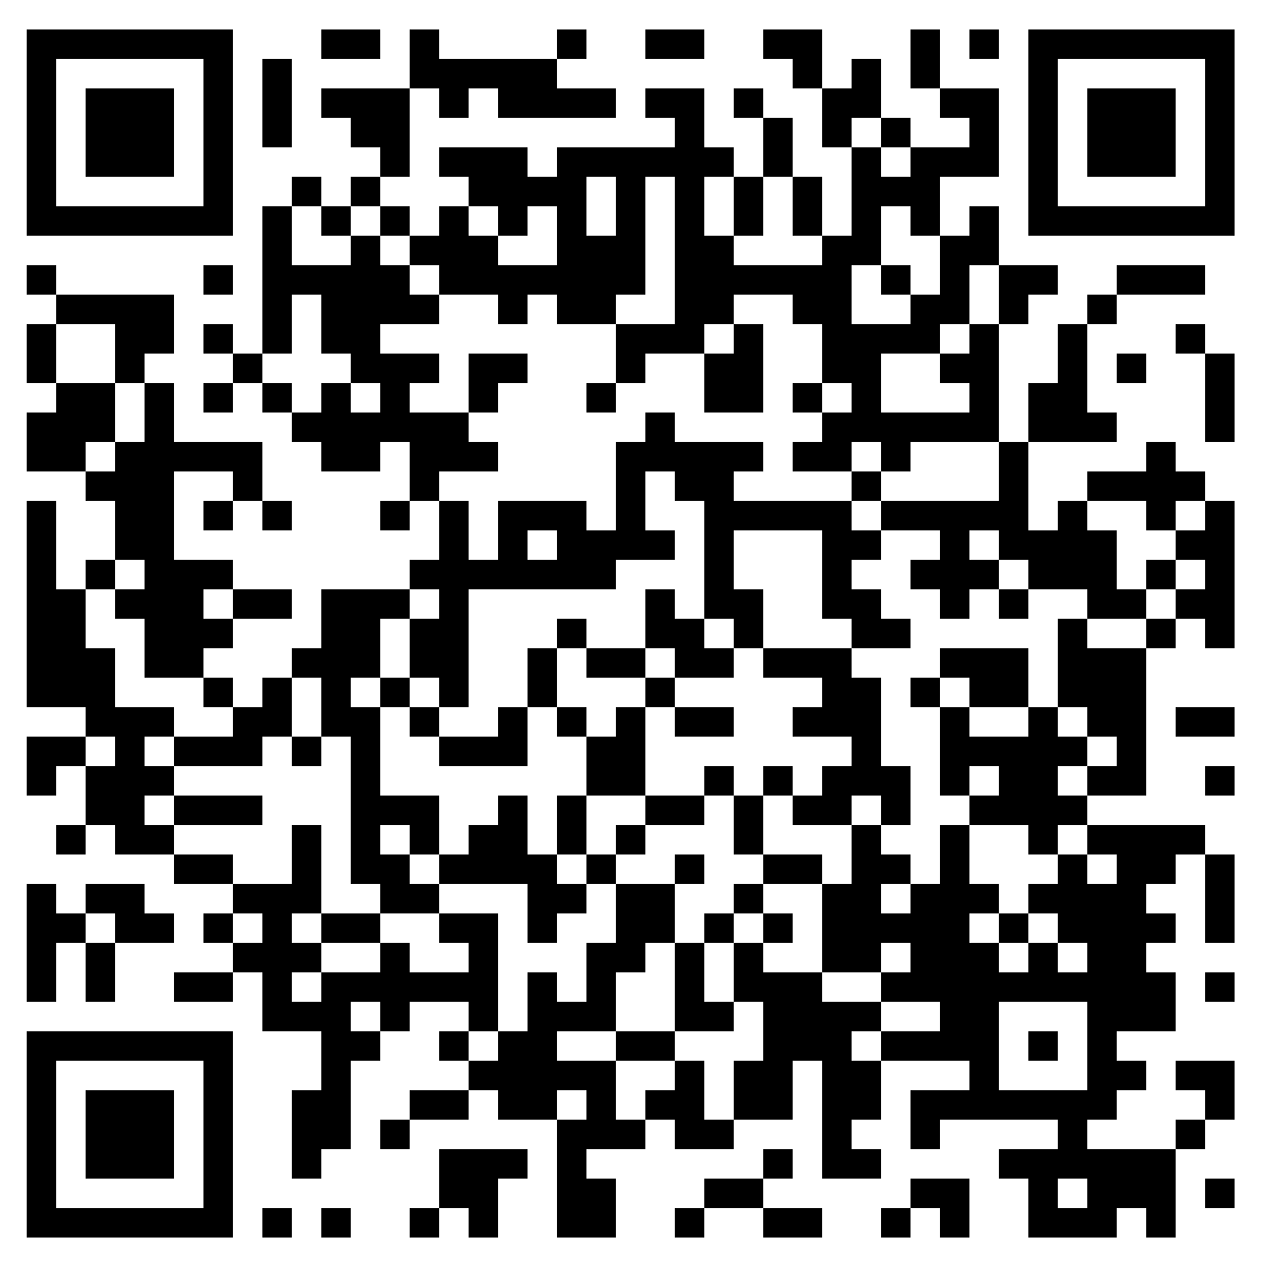
Differing Priorities
The Clinician
  I can heal your body
The devout Catholic
  I wish to save my soul
Notes:
Religious rights have the same protection in law as racial, sexual and other equality rights. If you allow a Catholic to exercise their religious rights, they may choose to die sooner but die happier. You may believe there is no afterlife where they can be rewarded, but that is not your decision to make.

Slide 8
Heroic choices
Treatment while pregnant? Prioritise baby
Withholding data for genetic screening
Notes:
Catholics are not obliged to do certain things but may want to do so in the belief that they will be rewarded by God. Gianna Molla and Chiara Corbella Petrillo

Slide 9
Catholic Ethics
Revd Dr Gareth Leyshon
2026 Conference
Gareth.Leyshon@
cardiffmenevia.org

