Slide 1
What’s wrong with assessment in medical education? How can we assess more authentically + how can technology help, rather than hinder us?
Please support: https://www.redcross.org.uk
Richard Fuller
Christie Education, UK

Slide 2
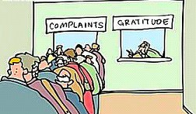
What’s wrong with assessment?
Moans
Groans
Irritations
https://www.insidetimeshare.com/fridays-letter-america-11/complaint-queue/

Slide 3
Looking back to the future
Assessment and technology in medical education

Slide 4
A test: Some sacred cows of HPE assessment
Assessment drives learning?
Simulation = transfer = automatic performance in practice
Reliable, high stakes test are ‘the best’
Feedback = scores and grades

Slide 5
Tools, tools and tools – WBA and EPA
Doing data differently – numbers or words?
Advent of programmatic assessment and technology testing… (still grappling with professionalism!)
Tools, tools and tools! - The rise of the OSCE
Statistics, standardization and structures
Grappling with behaviours and professionalism assessment
‘Traditional’ assessment tools without curricular alignment; Focus on knowledge and some performance

Slide 6
Concerns and challenges
Learners:
Purpose? Discordant views of learner/supervisor
Output? Tick box exercises and gaming
(Harmful) impact of simply ‘measuring’ of assessment activities (Archer and Prinsloo 2019; Foster and Francis 2019)
Faculty
Skills to deliver effective supervision and feedback?
Relationships and power dynamics: ‘weaponizing’ measurement
Organisations
Making time to deliver assessment (alongside everything else)
Creating appropriate learning environments
Making time for faculty development

Slide 7
Failure to embrace messages and lessons from wider education
Taxonomies, tools and pedagogies
Evolution of taxonomies to absorb metacognitive functions, student engagement, motivation and behaviours
Active engagement with established and new assessment ideas (e.g., Sambell and Brown 2019, 2020).
Assessment (fit) for learning with actionable feedback (Wiliam; Boud); Non graded passes (Dahlgren, Tannock)
Authentic, active assessment? Challenge, and desirable difficulties (Bjork & Bjork)
Compassionate assessment? Supporting learners, faculty and patients.
Actively link assessment outcomes with healthcare outcomes (e.g., Tamblyn)
Net result = failure to move towards ‘sustainable assessment’ (Boud, Boud & Soler)

Slide 8
Are we too dependent?
Initially transformative, but does it now restrict our thinking?
Focus on tools, not systems
Assessment = pass fail
Feedback = absent or ‘grade justification’
Processes = institutional requirements and regulations

Slide 9
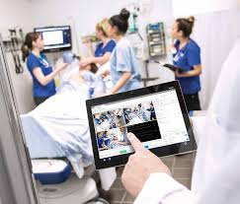
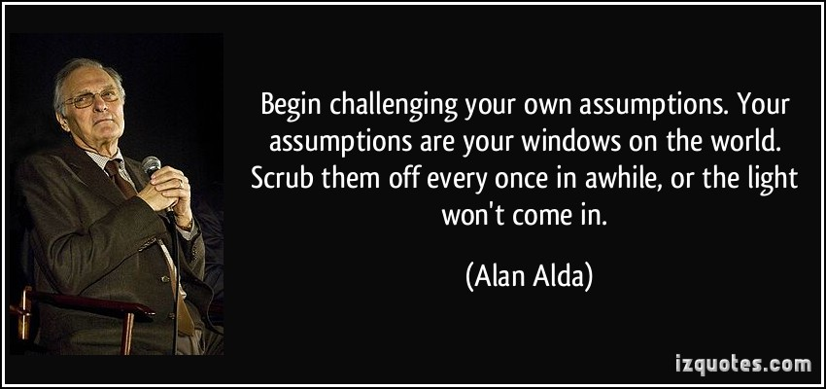
Can the rise in educational technologies (for assessment) in health education ‘save’ us ?

Slide 10
Shout out… Think about the last year
What has the been most transformative/helpful/exciting change to the way you educate using technology?
Think about your practice in the lab, campus, classroom, clinic

Slide 11
Communication, connectivity, creativity and collegiality
Better ‘assessment talk’?
Engaging, and co-producing/creating, with learners and faculty (Cumbo and Selwyn 2021 )
Creativity in authentic assessment
Design, and scheduling of assessment; increased focus and creativity in assessment for learning and adaptive testing
Innovation cultures
Medical Education ‘Really Good Stuff’
Building faculty confidence in using technology to enhance assessment (Ashokka et al 2020; https://tinyurl.com/sjww5z8)
https://en.wikipedia.org/wiki/The_Good,_the_Bad_and_the_Ugly
Notes:
Some of the recent good….
https://en.wikipedia.org/wiki/The_Good,_the_Bad_and_the_Ugly

Slide 12
Tech heavy, theory light, design absent?
What exactly is a virtual OSCE?
Online and/or open book tests?
Retrofit decision making
Misuse of assessment for learning data and the potential harm of Artificial Unintelligence (Broussard)
Unintended consequences
Transmediation and error (Ottawa consensus)
Inauthenticity and assessment of ‘wrong’ construct
Notes:
Now the bad – and the uncertainty for learners and candidates

Slide 13
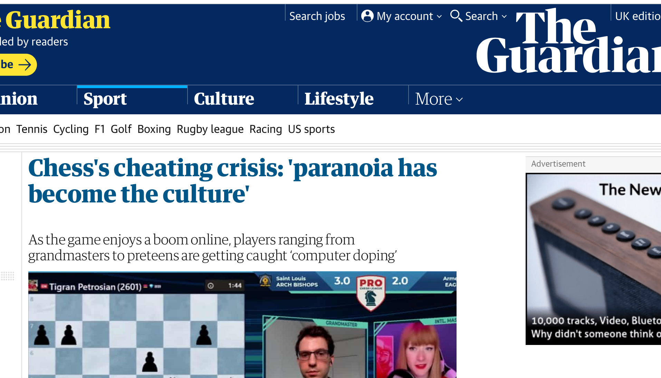
Have we lost our way?
Multiple overlapping views from learners, faculty, employers, patients (e.g., Roberts et al. 2020; Selwyn et al. 2021; Bali 2021)
Technology = cheating
Proctoring, lock down browsers and drones = discourse of mistrust
Adversarial systems = risk:
Complex processes and cognitive load
What data is gathered? Security
Notes:
And now the frankly ugly – signpost lessons and skill from wider HE
https://www.theguardian.com/sport/2020/oct/16/chesss-cheating-crisis-paranoia-has-become-the-culture?CMP=Share_AndroidApp_Other

Slide 14
Technology under the education spotlight?
Risk that a ‘focus on measuring’ may cause a fait accomplit for some learner groups and drive towards failure (Archer & Prinsloo, 2019)
Further risk that use of ‘algorithm driven’ approaches lead to ‘gamed learning’ ( = treating learners as machine learners) (Broussard 2018) and promotes undesirable behaviours (Foster & Francis, 2019)
Minimal evidence base investigating effectiveness of AI/ analytics interventions on outcomes (Sonderlund et al, 2018; Foster & Francis, 2019)
Misuse, misinterpretation and misapplication of learning analytics (Lawson et al, 2016)
Notes:
RF
Achievement gap!!!?!

Slide 15
How can we assess more authentically, and enhance with technology?
Back to theory and evidence
Framework from the Ottawa Technology Enhanced Assessment Consensus, 2022

Slide 16
Embrace messages and lessons from wider education
Taxonomies, tools and pedagogies
Evolution of taxonomies to absorb metacognitive functions, student engagement, motivation and behaviours
Active engagement with established and new assessment ideas (e.g., Sambell and Brown 2019, 2020).
Assessment (fit) for learning with actionable feedback (Wiliam; Boud) Non graded passes (Dahlgren, Tannock)
Authentic, active assessment? Challenge, and desirable difficulties (Bjork & Bjork)
Compassionate assessment? Supporting learners, faculty and patients.
Actively link assessment outcomes with healthcare outcomes (e.g., Tamblyn)
Net result = move towards ‘sustainable assessment’ (Boud, Boud & Soler)

Slide 17
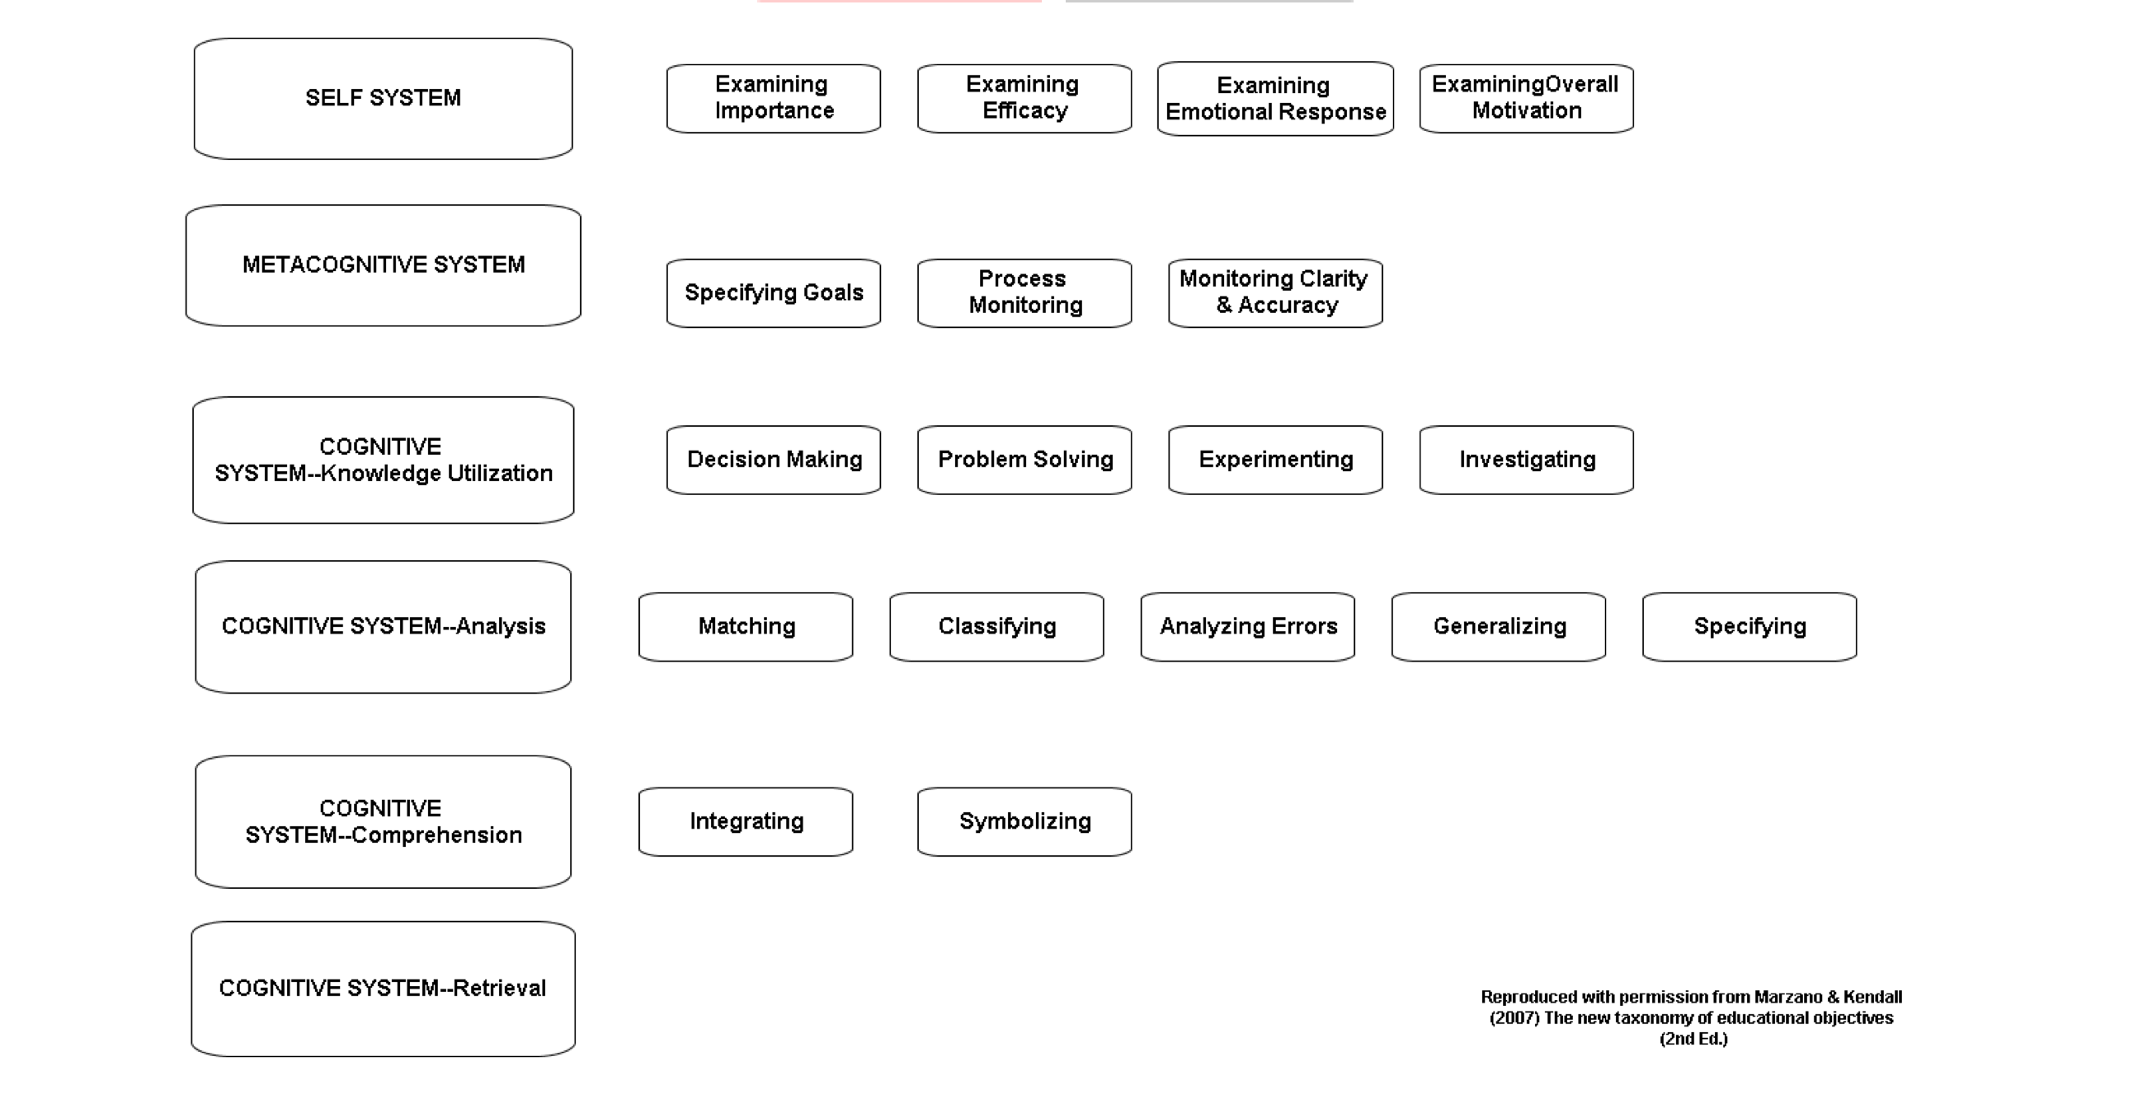
Marzano’s New Taxonomy (2000); Marzano and Kendall (2008)
https://files.eric.ed.gov/fulltext/EJ1263740.pdf
Tasks and learner engagement and motivation

Slide 18
Some assessment design challenges …
Your chance to escape the tyranny of the SBA and OSCE
What is the purpose of assessment?
For the us? For our learners?
How can we test differently with technology?
How can we influence learner behaviours as a consequence?
https://www.forbes.com/sites/eliamdur/2020/12/12/12-ways-leaders-generate-ideas/?sh=1ad8b29430ce

Slide 19
Cognitive – retrieve, comprehend (apply)
Scenario : Module assessment on ethics and law
Traditional test: MCQ
Think of a different way of testing +/- uses technology and engages students (+/- makes it fun!)…
Suggestion: Create a media performance (self/group)
Alex Webb (ANU) – ‘how can we show it, if we can’t see it?’
Novel ways of assessment for anatomy (student generated YouTube videos for anatomy) - RLO

Slide 20
Cognitive – analyse, specify, generalise
Scenario: SSC / Case study on patient management /illness
Traditional test: Essay or report
Think of a different way of testing +/- uses technology and engages students (+/- makes it fun!)…
Suggestion
E-Poster or Patient Information Leaflet?
Assessment task produces an output to support student achievement (e.g., conference abstract) or can be used in patient care

Slide 21
Cognitive – Planning, decision making, problem solving (Utilise)
Scenario: OSCEs and workplace assessments are good at observing learners care for individual patients, but how can we assess ability to decide how to prioritise which patient to see first/deal with a complex ethical scenario?
Traditional test: ??? Sometimes a MCQ!
Think of a different way of testing +/- uses technology and engages students (+/- makes it fun!)…
Suggestion
In tray exercise – prioritizing patient care from a series of referrals or handover/handoff
Situational awareness exercise - https://youtu.be/jDcrfVZoEsE - can use in a variety of ways to help assess dynamic decision making and group discussion
introduce ‘desirable difficulty and challenge

Slide 23
Plan for a better (technology enhanced) assessment future… ?
Put down the technology – pick up the pedagogy
Is your assessment fit for technology?
How clear is the purpose of your assessment? Is it really best practice, or ready for ‘retirement’? (Norcini et al 2018)

Slide 24
Deal with the digital divide. It’s more than just devices!
Programmes
Good design that uses technology intentionally to improve access and engagement
People
Use of simpler, cross platform tools with skills/literacy education to support assessment in multiple environments (e.g., Top Tools for Learning Jane Hart 2007-)
Address the needs of learners, faculty and patients to use technology to learn authentically in workplaces
Processes
Consider whole system design to ensure that the benefits of improved equity are not negated by restrictive institutional processes
Seek out experience and expertise from low resource implementation of (educational) technology – e.g., frugal innovation cultures (Tran, 2016)

Slide 25
Whole system design (Jisc 2016)

Slide 26
1. Advancing assessment authenticity
Pedagogically
Greater focus on personalization and the quantified self – helping learners judge their own progress and improvement plans (e.g., Malecka & Boud 2021)
Technically
Place learners and faculty of the heart of design (Divami 2021)
Clinically
Where can we align technology assessment with technology augmented learning and care provision? How do we practice clinically?
Device augmented care?
Health technology literacy, risk communication, decision making (evidence and guidelines)?

Slide 27
2. Learner engagement matters

Slide 28
3. Enhancing design and scheduling
When do I test?
Rethinking large scale tests, and the rise of programmatic and personalized testing (van der Vleuten)
How do I test
Growth of customized and adaptive testing
Open book (Bengstsson 2019)
Individual or teams?
Books, or technology ?
Where do I test?
Campus, clinical or remote (BYOD - e.g., Sungren, 2017)
Importance of test ‘environment’ and support (Harley et al 2021; Tweed et al 2021)
Equity and access matter!
What am I testing?
Clinical competence?
Ownership/curation of assessment and longitudinal development (Clarke & Boud 2018)

Slide 29
4. Rebuilding faith in assessment partnerships
Commentary and concern (Roberts et al. 2020; Selwyn et al. 2021; Bali 2021)
Trust
Professionalism
Proportionate proctoring
Detection and security
Clarity of consequence (positive and negative behaviours)
Lessons for learners, Faculty and Institutions

Slide 30
5. Achievement and improvement: Is learning taking place?
Evaluation and Dissemination!
‘Be a critical consumer of education research’ (Dylan Wiliam)

Slide 31
5. Is learning taking place?
Use technology wisely
‘Profile and punish’?
Gather and guide!
Collecting the ‘right’ data and visualizing it effectively
Supporting learner agency and choice (e.g., Broos et al, 2019)
Guiding feedback and ‘action’ (rapid remediation, coaching and mentoring, nudges)
What about faculty and organizational learning?
Using data wisely
Supporting learner groups (Foster & Siddle 2020)
But whose data is it ?? (Tsai et al. 2020)

Slide 32
Looking to the future
Increased value on ‘human only’ traits and that which can not be ‘automated’
How to ‘assess’?
Compassion
Creativity
Inclusivity
Decision making (and abdication) with tech
Ethics
https://www.theagilityeffect.com/en/article/humanity-and-technology-risk/
Notes:
Emphasis on the new challenges for assessment in HPE in a semi-automated world
https://www.theagilityeffect.com/en/article/humanity-and-technology-risk/

Slide 33
Aspiring for a better assessment technology future?
Design based (technology enhanced) assessment aligned with authentic healthcare
Assessment = learner engagement and diagnosis
Feedback = intervention and improvement (metacognitive/self)
Systems = Demonstrating learner development, competence and delivery of safe care
Time to change our assessment culture… collegiality, communication, care and partnership with our learners and patients (Fuller at al 2020)
Notes:
How to rethink ‘beyond competence’

Slide 35
For supporting references, comment, further discussion, please get in touch
richardfuller@nhs.net
Please support: https://www.redcross.org.uk

Slide 36
Gathering data, making decisions
Growth of Programmatic assessment
Multiple, low stakes assessment using appropriate tools and a range of assessors throughout a programme
Each focuses on learning and feedback
Combined together to guide, and decide, progress
Result = more compassionate, adaptive approaches to assessment, remediation and development (van der Vleuten, multiple; Ottawa consensus statement 2021)

